Slide 1

Slide 1
TARANG HARIA
Portfolio
Masters in Information Technology and Analytics

Slide 2
About
Experienced Digital Marketing Analyst with a demonstrated history of working in the Marketing, Advertising, Education & Real Estate industry. Skilled & certified in Google Analytics & AdWords, Python and R. Strong marketing professional with a Master's degree focused in Information Technology & Analytics from Rutgers University.

Slide 3
PROJECTS COMPLETED
Raj Group
Ajmera
Kukreja
Sunteck
Billabong
Saregama Caravan

Slide 4
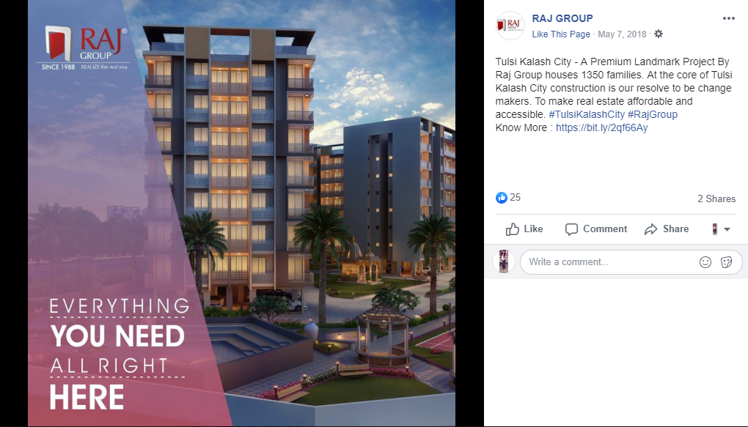
RAJ GROUP FACEBOOK ADS
AVG CPC | INR 45
AVG CTR | 6.5%
Avg CPL | INR 50

Slide 5
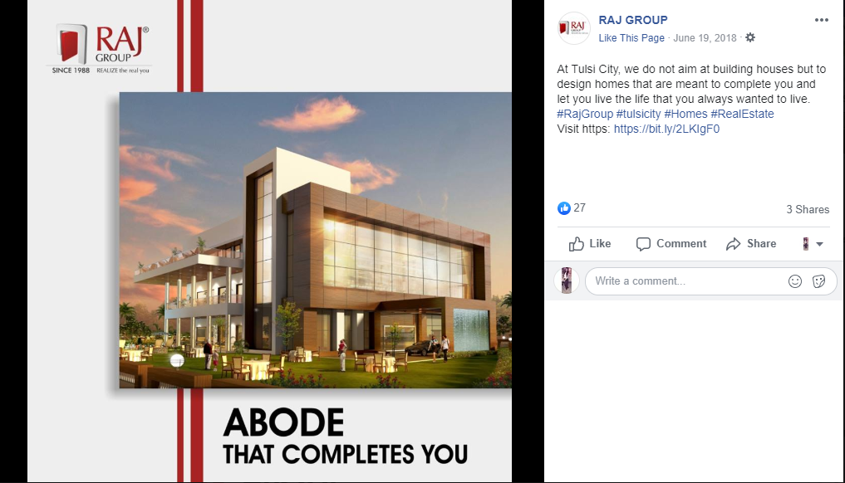
RAJ GROUP FACEBOOK ADS
AVG CPC | INR 30
AVG CTR | 6.5%
Avg CPL | INR 50

Slide 6
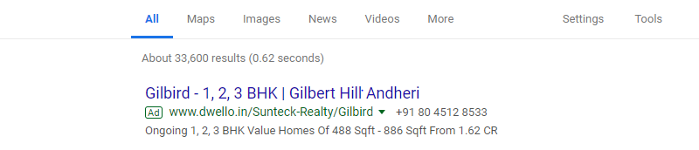
SUNTECK – GOOGLE ADS
AVG CPC | INR 45
AVG CTR | 3.9%
Avg CPL | INR 450

Slide 7
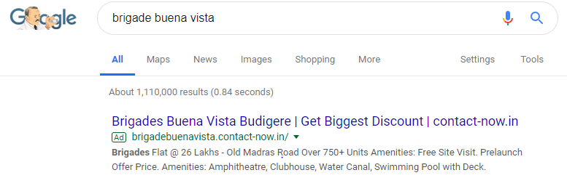
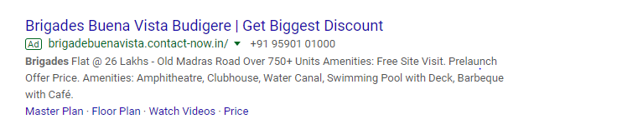
Slide 6
BRIGADE GROUP – GOOGLE ADS
AVG CPC | INR 50
AVG CTR | 3.5%
Avg CPL | INR 350

Slide 8
Billabong Keywords Suggestion
Sr No | Keyword | Volume
1 | Schools in thane west | 390
2 | top schools in thane | 320
3 | best schools in thane west | 140
4 | top 10 schools in thane west | 30
5 | icse schools in thane west | 70
6 | best icse school in thane west | 70
7 | top 10 schools in thane | 480
8 | preschool in thane west | 70
9 | igcse school in mumbai | 880
10 | daycare in thane west | 30
11 | best international school in thane west | 20
12 | billabong high international school mumbai | 170
13 | top icse schools in thane | 30
14 | top 10 international schools in mumbai | 210
15 | icse school in airoli | 70

Slide 9
Billabong Keywords Suggestion
Sr No | Keyword | Volume
16 | icse school in bhandup | 40
17 | schools in mulund west | 210
18 | best school in airoli | 210
19 | international schools in mulund | 70
20 | international schools in airoli | 50
21 | international schools in bhandup | 30
22 | international schools in vikhroli | 20
23 | best school in airoli | 210
24 | best school in mulund | 170
25 | best school in bhandup | 90

Slide 10
Slide 1
THANK YOU

